Slide 1
Automating DevOps project
ENG:Mennatallah abdelhamid

Slide 2
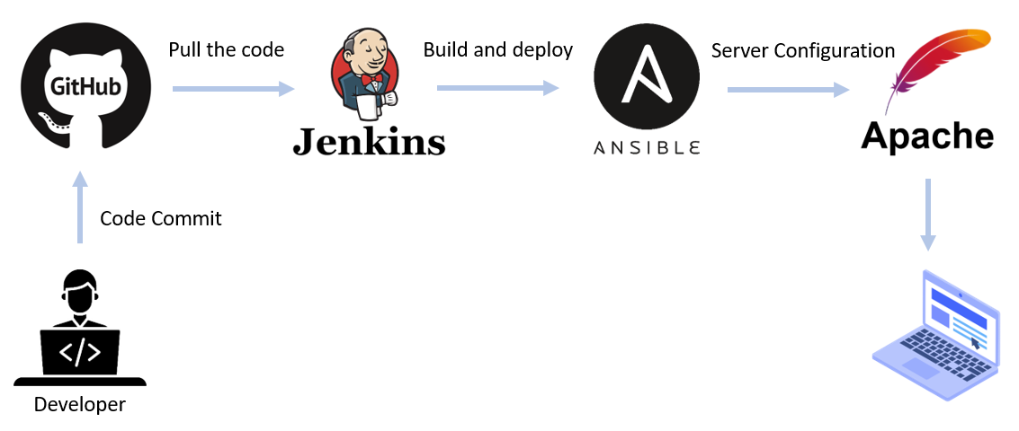

overview
this project shows the Integration between GitLab, Jenkins, and Ansible to install Apache webserver and using Bash scripting to provide a robust automation framework for managing infrastructure and orchestrating CI/CD pipelines

Slide 3
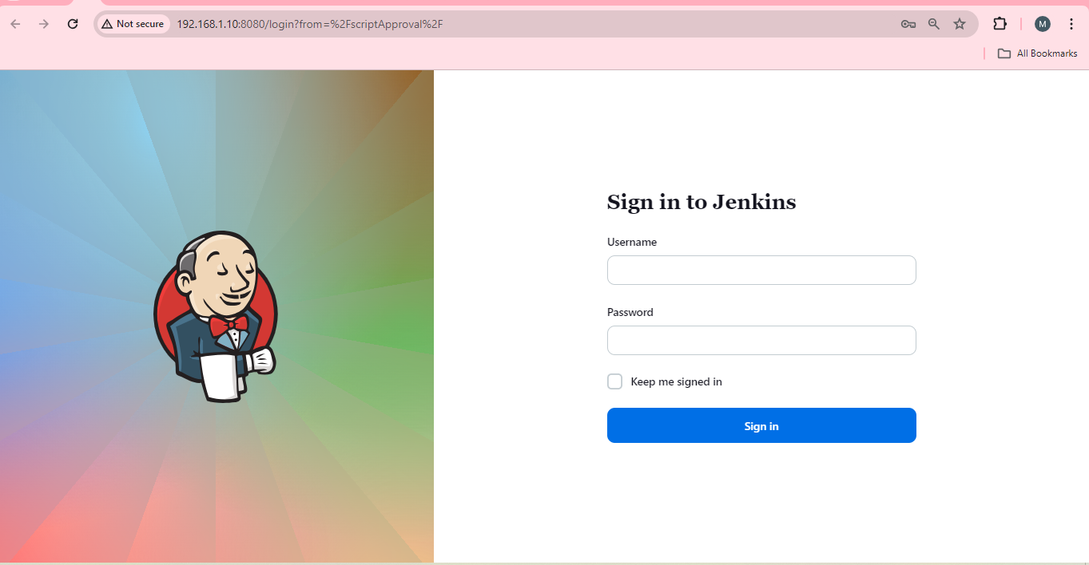
dedicated Jenkins server for orchestrating the CI/CD pipeline

Slide 4
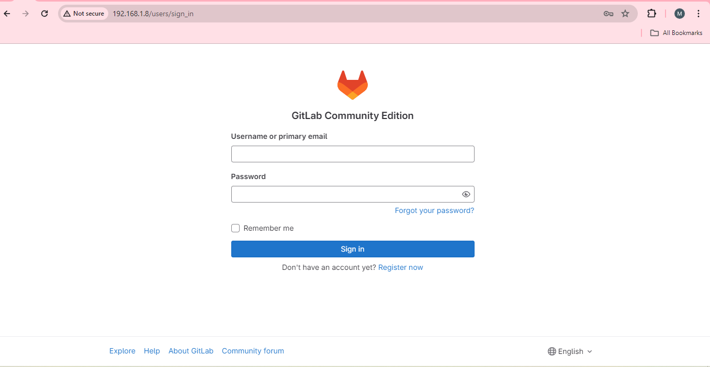
Implement a private GitLab instance for hosting Git repositories

Slide 5
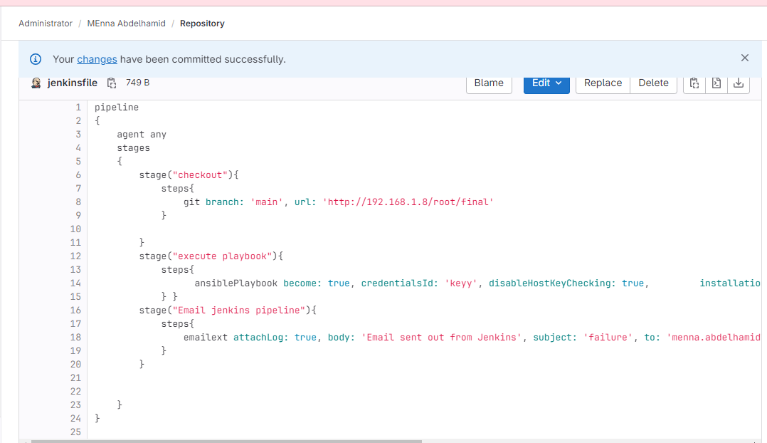
Integration with Jenkins and gitlab create pipeline

Slide 6
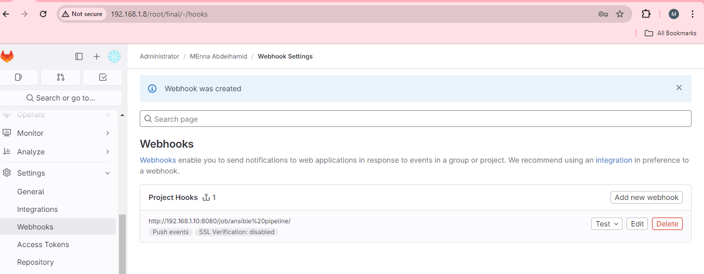
Configure Jenkins to monitor the GitLab repository for any code changes (commit in main branch ) using webhook

Slide 7
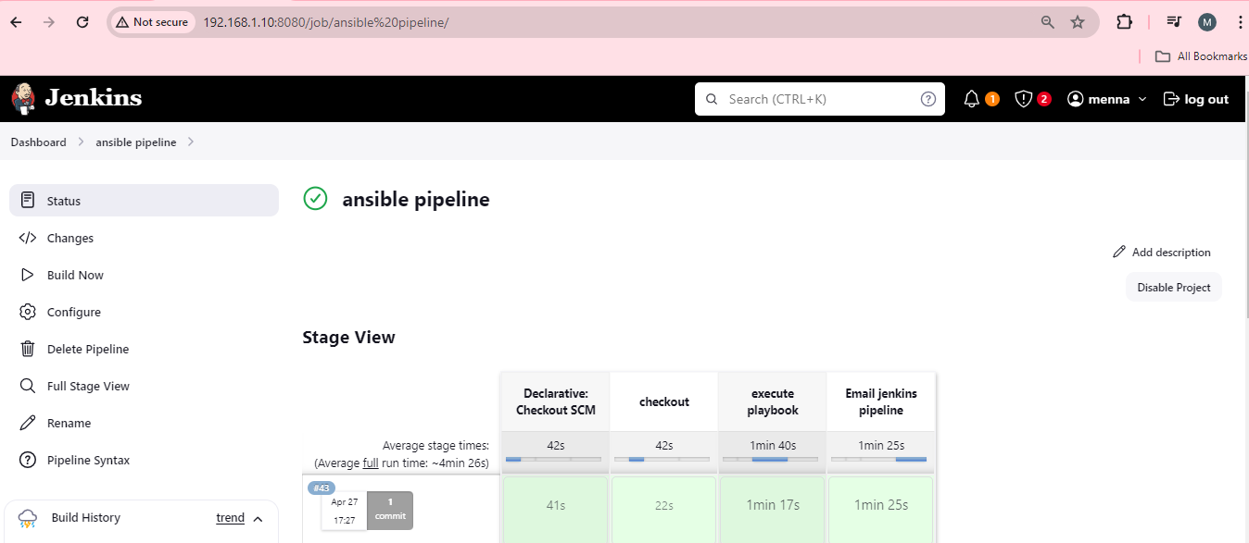
This stage view shows the stages of the pipeline

Slide 8
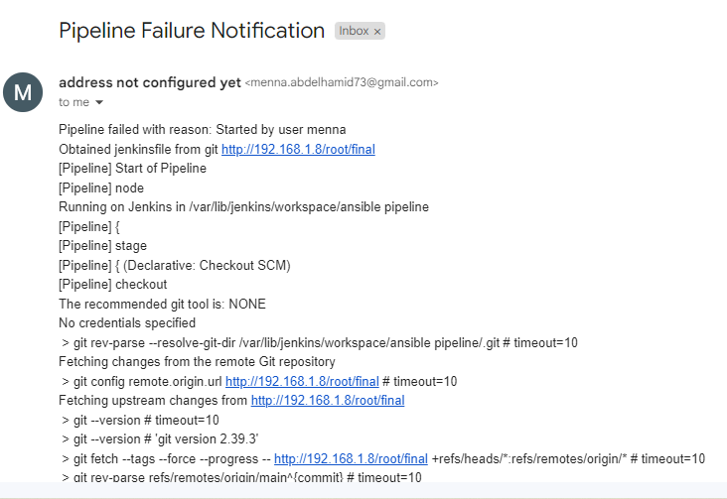
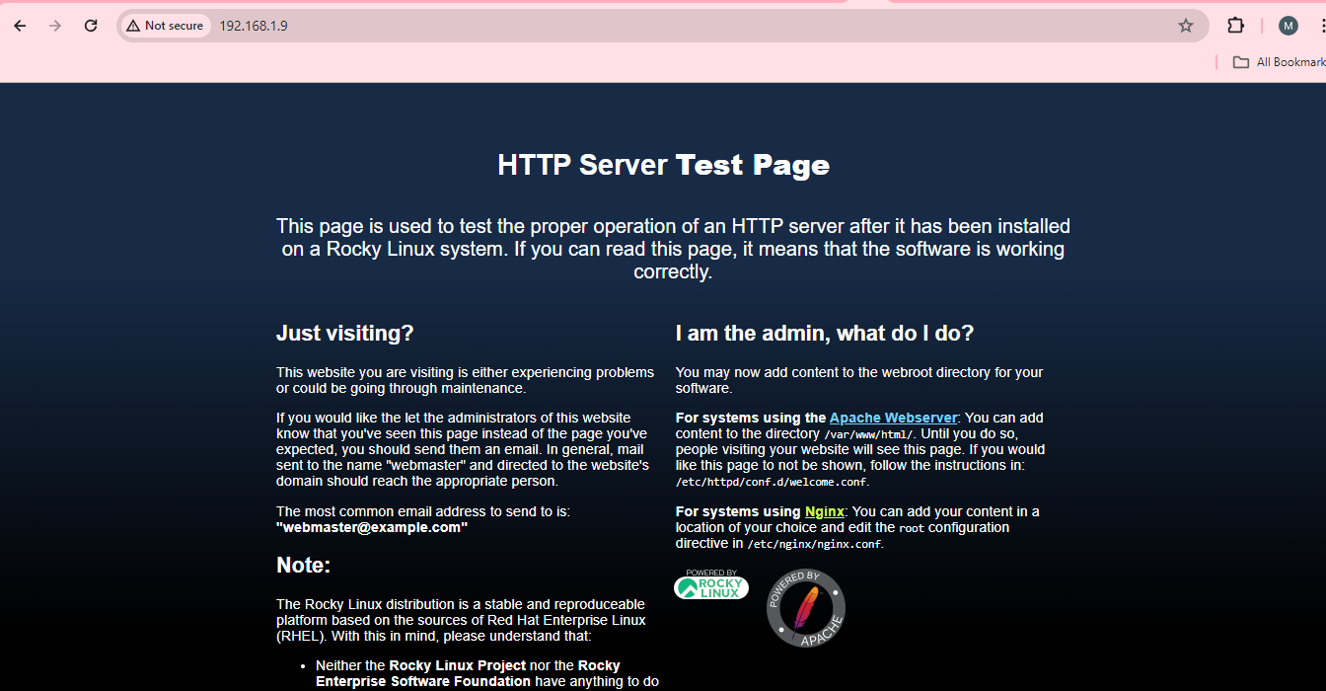
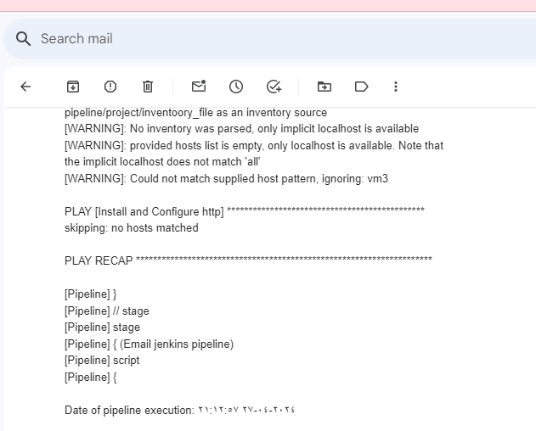
Now, Apache web server is installed and configured any failure is sent by email notification

